Slide 1


Zomato Restaurant Success Prediction
Katkar Amol J. (1304)
Kharat Ganesh B. (1359)
Prashant Karhale Akshay Tilekar (External Guide)
Center Coordinator
Presented by:

Slide 2
Introduction
Zomato Restaurant Success Prediction
Zomato is the most reputed company in the field of food reviews. Founded in 2008, this company started in India and now is in 24 different countries.
It is so big that the people now use it as a verb. “Did you know about this restaurant? Zomato it”. The rating is the most important feature of any restaurant as it is the first parameter that people look into while searching for a place to eat.
It portrays the quality, hygiene and the environment of the place. Higher ratings lead to higher profit margins. Notations of the ratings usually are stars or numbers scaling between 1 and 5. Zomato has changed the way people browse through restaurants. It has helped customers find good places with respect to their dining budget.
Different machine learning algorithms like Linear regression, Decision Tree, Random Forest can be used to predict the ratings of the restaurants.

Slide 3
Zomato Restaurant Success Prediction
Purpose
Zomato is an Online food ordering service, serving worldwide in which users can order food from the website or from mobile based applications. For this business problem, we are restricting only to the Bangalore region and Bangalore based restaurants. Dataset was created by extracting (web scraping) the information such as Approx. Price of food, Theme based restaurant or not, aggregate rating of each restaurant etc. about the existing established restaurants serving through Zomato and made available on Kaggle March 2019.
The basic idea of analyzing the Zomato dataset is to get a fair idea about the factors affecting the establishment of different types of the restaurant at different places in Bangalore.
Institute for Advanced Computing and Software Development, Akurdi

Slide 4
Overall Description
Zomato Restaurant Success Prediction
The given problem can be solved either by binary classification problem (0 as failure or 1 as success), or Regression problem (for predicting scores) based on the given features.
Approx. Price of food.
Theme based restaurant or not.
Which locality of that city serves that cuisines with maximum number of restaurants.
The needs of people who are striving to get the best cuisine of the neighbourhood.
Is a particular neighbourhood famous for its own kind of food etc.
Here, the objective is to predict the success of a restaurant. Based on the prediction from the Model, a new investor can make the decision on whether to establish the restaurant or not.
Institute for Advanced Computing and Software Development, Akurdi

Slide 5
Exploratory Data Analysis
Zomato Restaurant Success Prediction
Once understood the business problem and formulated the machine learning problem statement. We should be having a good knowledge of the datasets and most of the features. Now, we will do Exploratory Data Analysis on this dataset and to get more insights into the features.
From all the Data available, we can bring out some neat insights or conclusions such as
Which franchise has the highest number of Restaurants?
How many Restaurants are accepting online orders?
How many have a book table facility?
Which location has the highest number of Restaurants?
How many types of Restaurant types are there?
and so on.
Institute for Advanced Computing and Software Development, Akurdi

Slide 6
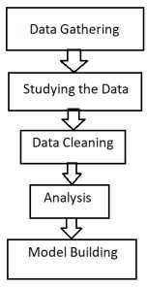
Proposed Methodology
Zomato Restaurant Success Prediction

Slide 7
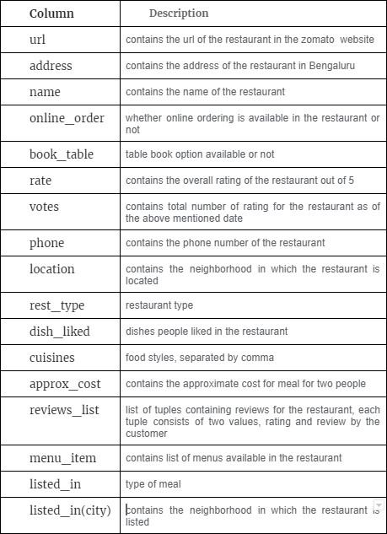
Dataset
Zomato Restaurant Success Prediction

Slide 8
Data Cleaning
Zomato Restaurant Success Prediction
‘rating’ column contains values such as ‘NEW’, which is for new restaurants and ‘-’, for those restaurants which are not rated. We will remove these records along with nan. ‘approx_cost (for two people)’ column contains values with comma; hence this is considered as object, we will convert it back to float.
We will also delete Unnecessary Columns ‘phone’, ‘url’. Analysis shows we a have total of 8385 restaurants listed in Zomato Bangalore. Restaurant ‘nu.tree’ is situated in 3 locations. Every outlet of this restaurant for a specific location is having a separate entry based on the features restaurant have such as Dine-out, Buffet & Delivery. i.e. We can have multiple records for the same restaurant in the dataset.

Slide 9
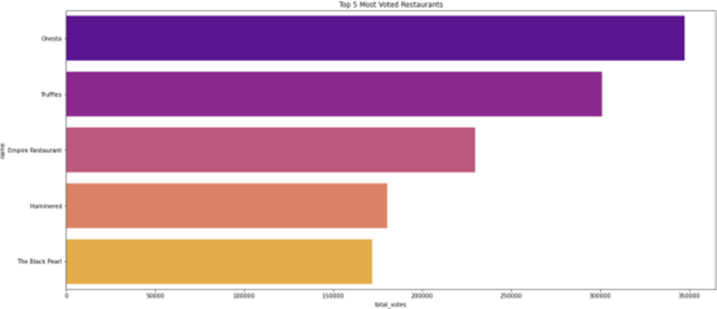
Analysis
Zomato Restaurant Success Prediction
Most Voted Restaurants

Slide 10
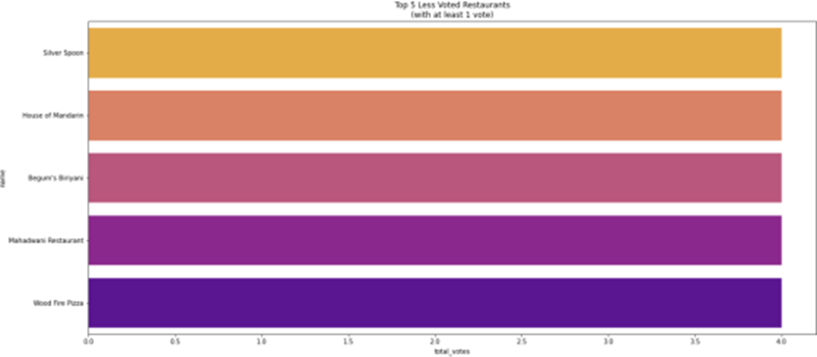
Zomato Restaurant Success Prediction
Least Voted Restaurants

Slide 11
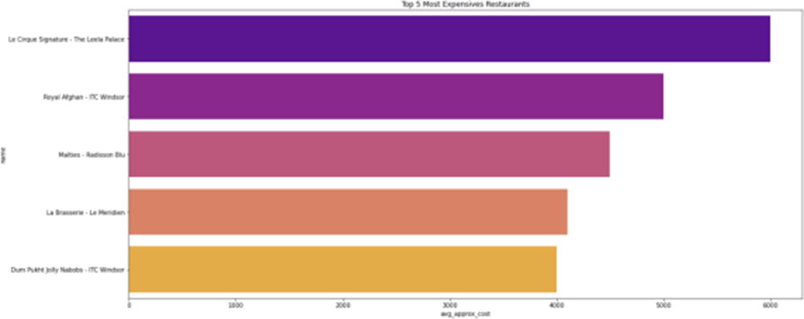
Zomato Restaurant Success Prediction
Top 5 Most Expensive Restaurants in Bangalore City

Slide 12
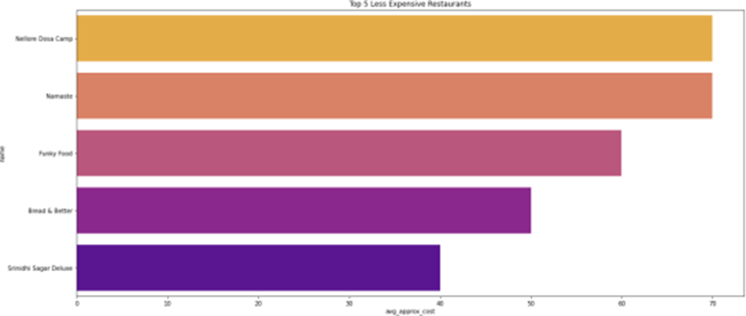
Zomato Restaurant Success Prediction
Top 5 Least Expensive Restaurants in Bangalore City

Slide 13
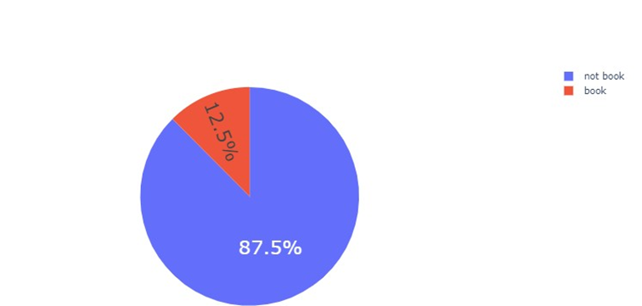
Zomato Restaurant Success Prediction
restaurants provide online ordering and booking table facility

Slide 14
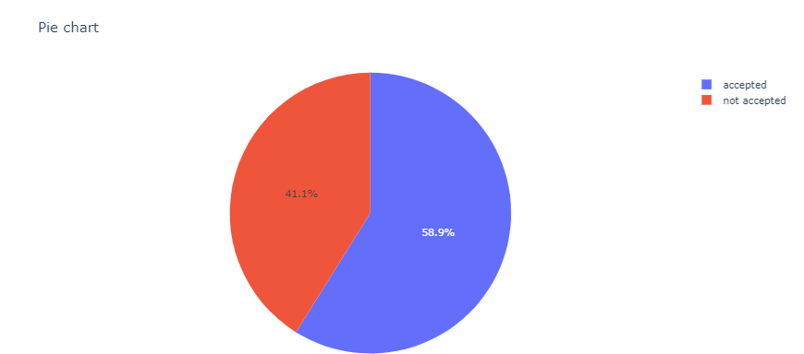
Zomato Restaurant Success Prediction

Slide 15
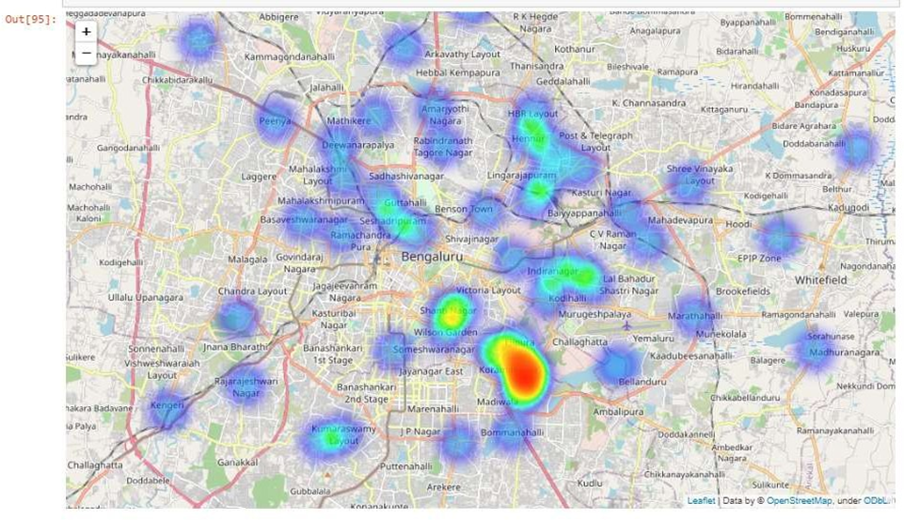
Zomato Restaurant Success Prediction
Restaurants Located in Bengaluru

Slide 16
Model Building
Zomato Restaurant Success Prediction
Assumptions: We won’t use the ‘votes’, ‘reviews’, ‘dishes_liked’ feature as long as this is a information we only know after launching a restaurant. As we want to be predictive, the idea is to return the probability of success of a restaurant before launching it.
Features:
• online_order
• book_table
• location
• rest_type
• cuisines
city
approx_cost

Slide 17
Zomato Restaurant Success Prediction
Split Data: We should first split data then apply featurization, to avoid data leakage problems. Divide data into Train, Test part.
Data featurization: We will use one-hot encoding technique for featurization to encode Categorical features such as ‘online_order’, ‘book_table’, ‘location’, ‘rest- type’ and ‘listed_in(type)’, listed_in(city).
We will train following models. Models:
• Logistic Regression
• RandomForestClassifier
• XGBClassifier
• DecisionTreeClassifier
• KNN

Slide 18
Results
Zomato Restaurant Success Prediction
Model | Accuracy
LogisticRegression | 0.7210
Naive Bayes | 0.6763
RandomForest | 0.7963
Decision Tree | 0.8291
KNN | 0.8019

Slide 19
Conclusion :
Zomato Restaurant Success Prediction
In this project we studied a number of features about existing restaurants of different areas in a city and analyses them to predict rating of the restaurant. This makes it an important aspect to be considered, before making a dining decision. Such analysis is essential part of planning before establishing a venture like that of a restaurant.
Lot of researches have been made on factors which affect sales and market in restaurant industry. Various dine-scape factors have been analyzed to improve customer satisfaction levels.
If the data for other cities is also collected, such predictions could be made for accurate.

Slide 20
Zomato Restaurant Success Prediction
Future Scope :
There is a lot to explore in this existing project. So, our future goal is to apply others algorithms in order to increase the accuracy score of our predictions regarding restaurants' rating obtained from both the features provided by restaurants and the reviews given by restaurants' customers.
We will try to make our system more user friendly by adding a user interface which enables the user to provide features that the user is planning to have for their restaurant as input and our system will provide the user with a rating from 1 to 5 that they will get for their restaurant.
Future work includes the use of unsupervised learning algorithms in conjunction to the supervised learning algorithms. This is because with the use of algorithms such as k-means clustering, the model is able to more closely to different geographic regions. Although a large k in this case would cause severe overfitting, a reasonable k value could result in a more accurate model due to differences in customers desires depending on the region. We also can try other classification algorithms.

Slide 21
Thank You
Zomato Restaurant Success Prediction

